Slide 1
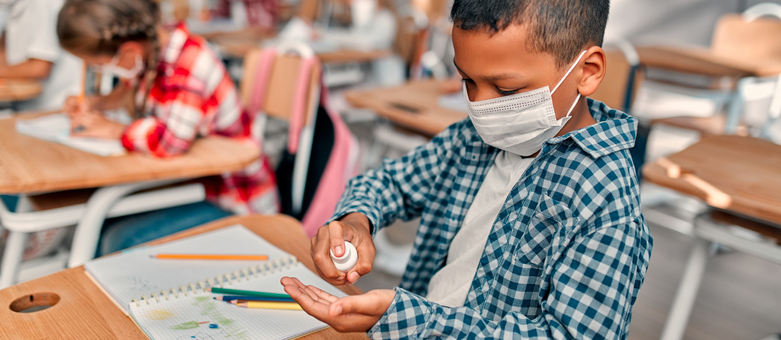
Event Address,
City, ST ZIP
Code
Free COVID-19 vaccines
All students at [participating school]
can get the COVID-19 vaccine free –
with or without insurance.
Return your
students consent form today!
Print the form at [website] or call []
Company Name
Address, City, ST ZIP CODE
Telephone | Email Address | Web Address

